Slide 1
Robotic Navigation and Exploration
Final Project
Min-Chun Hu
CS, NTHU
anitahu@cs.nthu.edu.tw

Slide 2
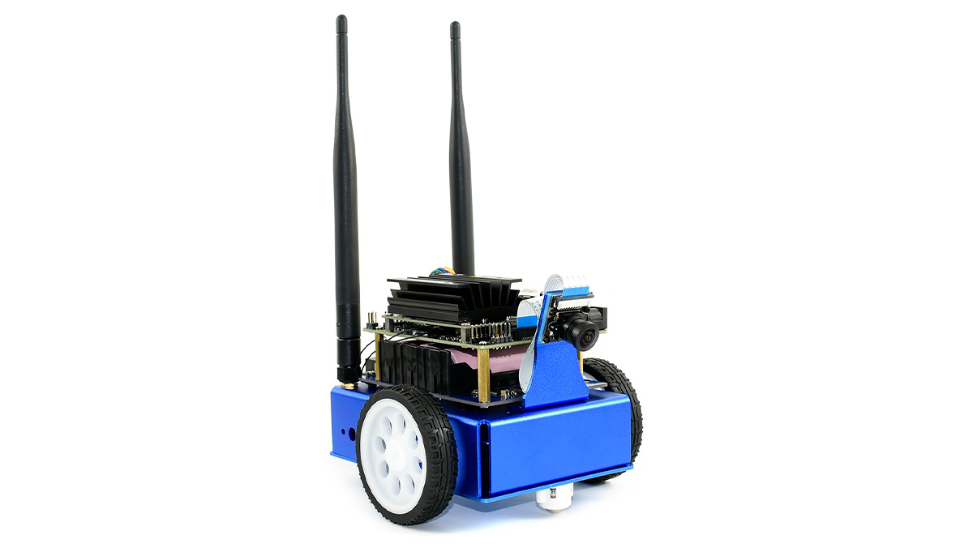
Basic-Automatic tracking schematic map
You should let your jetbot follow the line in the demo.
END
START

Slide 3
Advance – Parking schematic map
Try to park on the end sign as near as you can.
end
end
Basic
line
Perfect line

Slide 4
Advance – Avoidance schematic map
You should bypass the obstacles to reach the goal.
end
Collision!!

Slide 5
Score
 | Simulation (70%) | Real world (30%)
Automatic tracking | 35% | 12%
Parking | 15% | 9%
Avoidance | 20% | 9%

Slide 6
Simulation Environment

Slide 7

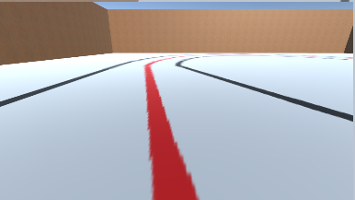
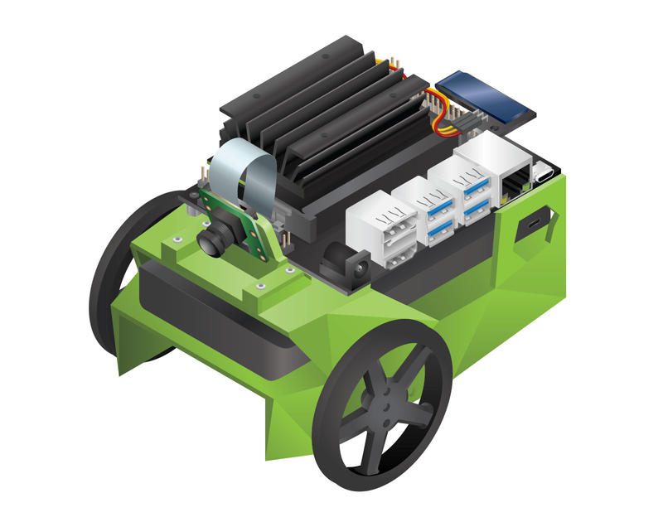
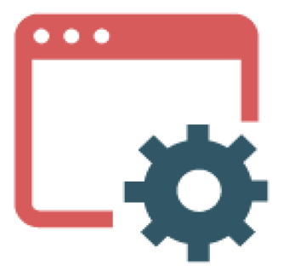



JetBot Simulator
Camera View
Message
Server
Control Signal
Physical Simulator
Wrapper
Link: https://reurl.cc/z8EK3e (for windows)

Slide 8
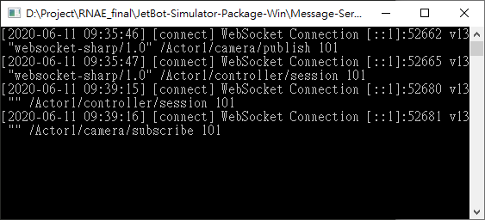
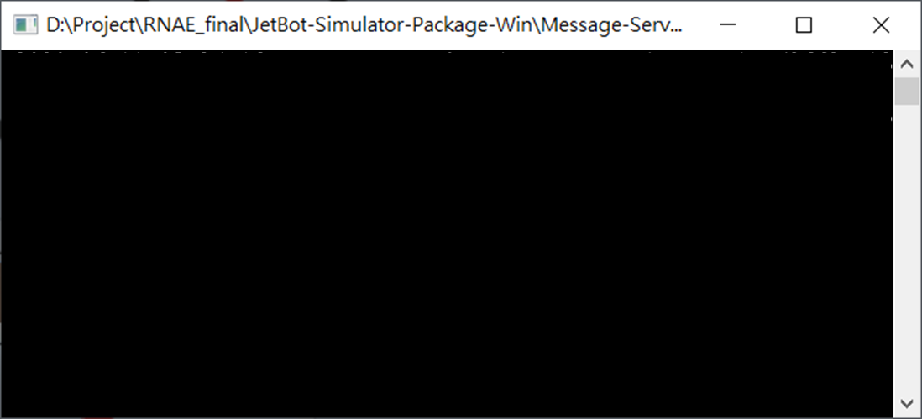
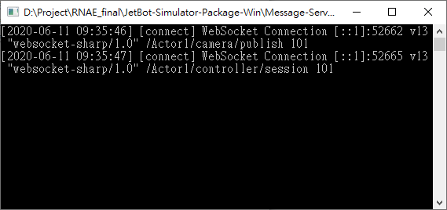
Message Server
Dataserver.exe
Run Server
Run Unity3D Simulator
Run Python Client
Run Python Client
Run Server
Run Unity3D Simulator

Slide 9
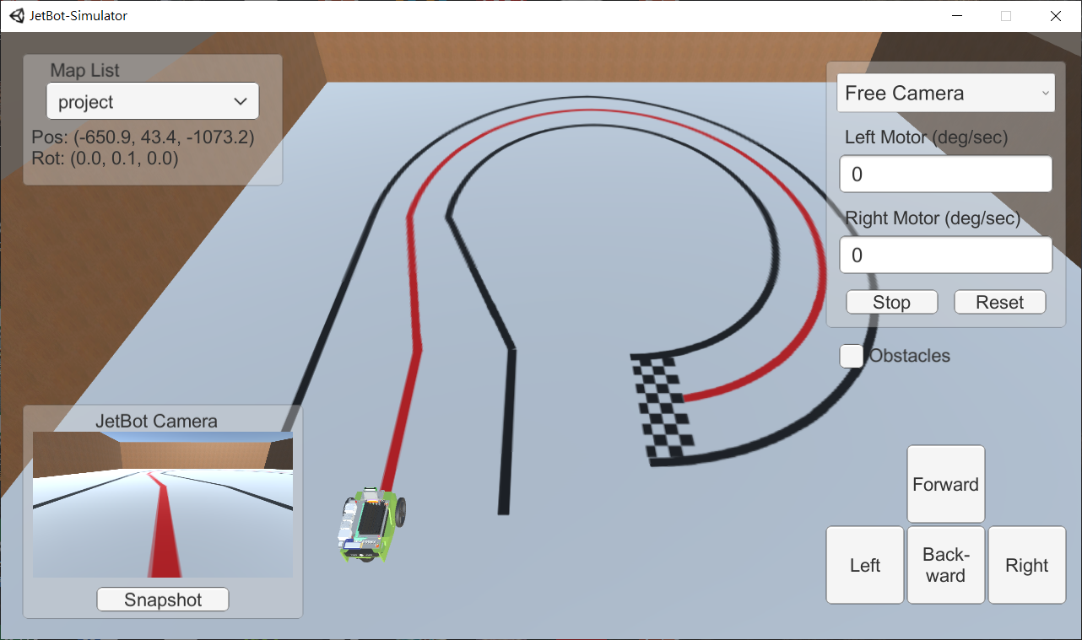
Unity3D Simulator
Map Selection
Simulator
Camera Switch
Set Motor Value
Camera on the jetbot
Take a photo (save at Unity-Simulator/Snapshot/)
Debug Control

Slide 10
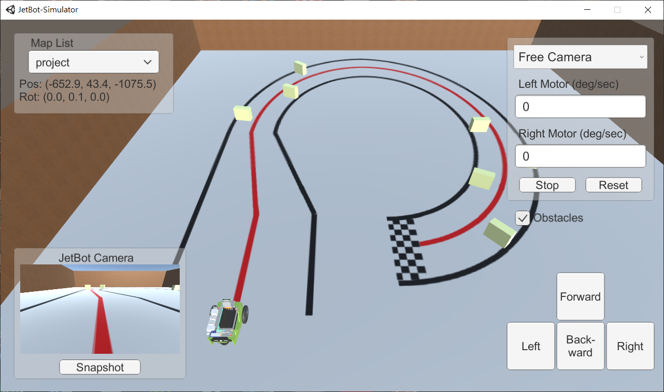
Obstacles

Slide 11
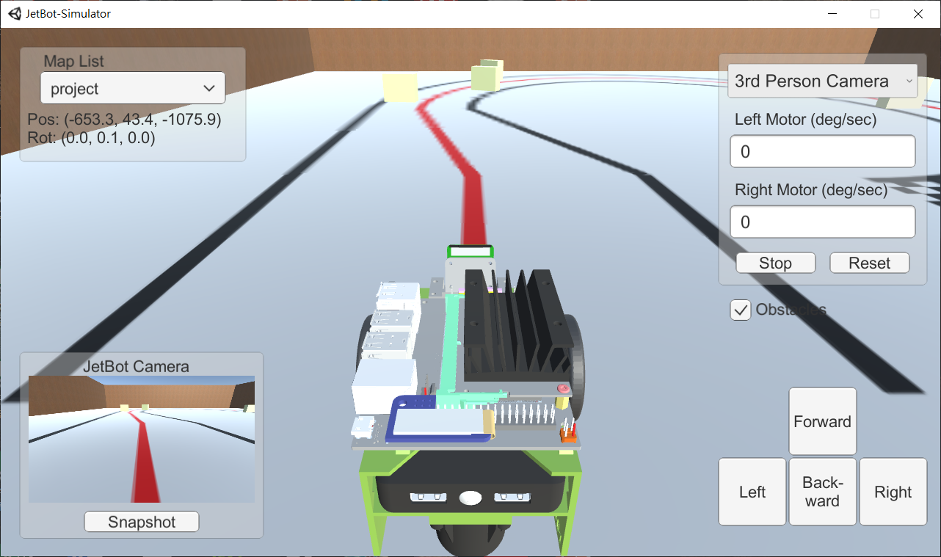
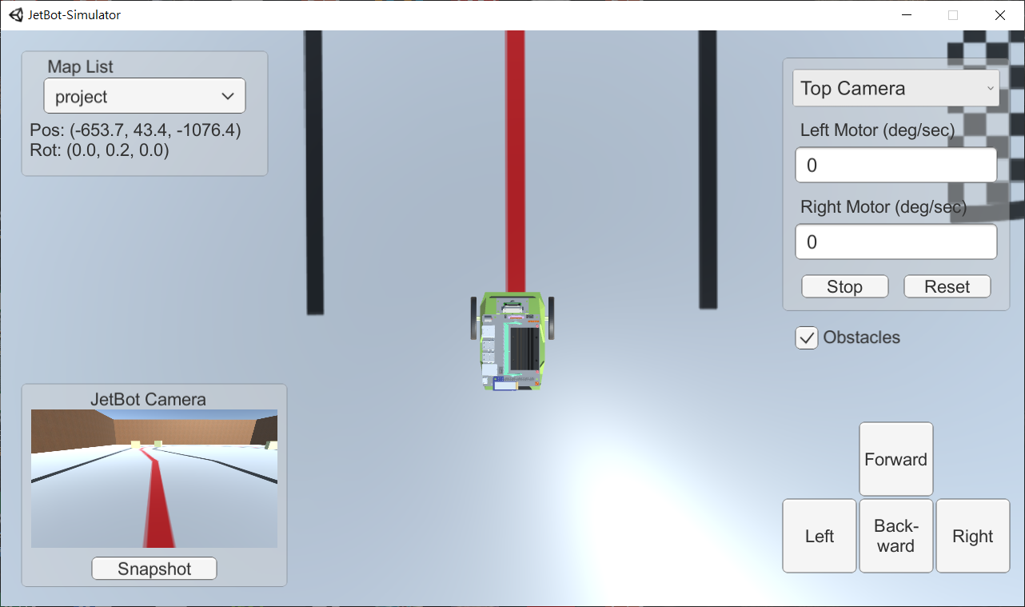
Camera Switch
Free Camera: The camera can be controlled by mouse.
3rd Person Camera: The camera is above behind the vehicle.
Top Camera: The camera is above the vehicle and captures the top view with orthogonal projection.
Free Camera
3rd Person Camera
Top Camera

Slide 12
Python Wrapper
jetbotSim
Camera
Wait for the camera data published by Unity3D simulator and invoke the callback function.
Robot
Send JSON-format control message to Unity3D simulator.
Note: The websocket library is required
pip install websocket
pip install websocket-client

Slide 13
Example
from jetbotSim import Robot, Camera
import cv2
frames = 0
def execute(change):
global robot, frames
print("\rFrames", frames, end="")
frames += 1
# Control Example
if frames == 1:
robot.forward(0.2)
if frames == 80:
robot.left(0.05)
# Visualize
img = cv2.resize(change["new"],(640,360))
cv2.imshow("camera", img)
robot = Robot()
camera = Camera()
camera.observe(execute)

Slide 14
Control API
robot.set_left_motor(value)
Left_motor = value
robot.set_right_motor(value)
Right_motor = value
robot.set_motor(value_l, value_r)
Left_motor = value_l
Right_motor = value_r
robot.add_motor(value_l, value_r)
Left_motor += value_l
Right_motor += value_r
Note:
The unit of motor value shown on Unity3D simulator (deg/sec) is different from the unit of control value in python wrapper (m/sec).

Slide 15
Control API
robot.forward(value)
Left_motor = value
Right_motor = value
robot.backward(value)
Left_motor = -value
Right_motor = -value
robot.left(value)
Left_motor = -value
Right_motor = value
robot.right(value)
Left_motor = value
Right_motor = -value

Slide 16
Control API
robot.stop()
Left_motor = 0
Right_motor = 0
robot.reset()
Left_motor = 0
Right_motor = 0
Set to origin

Slide 17
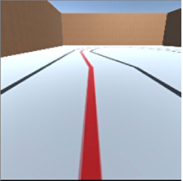
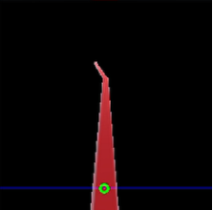
Hint
You can apply image processing and simple rule-base algorithm to detect the center of road and utilize P-control to track the road.
Detect
Horizon
Road
Center
P-gain

Slide 18
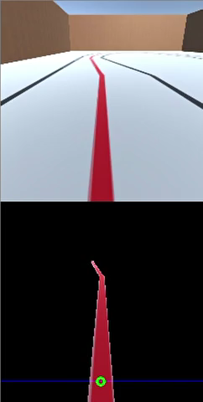
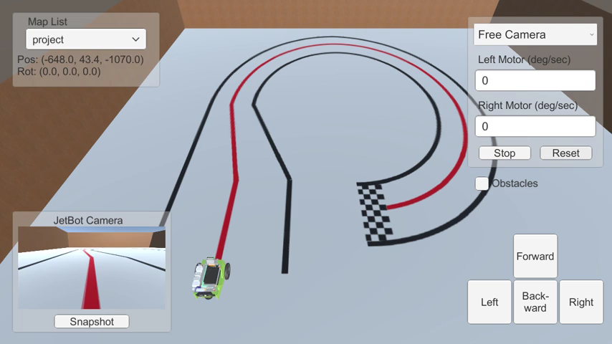
Demo

Slide 19
Real World Demo

Slide 20
Real world score – 30 points
 | Test map | Real map
Automatic tracking | 4 points | 8 points
Parking | 3 points | 6 points
Avoidance | 3 points | 6 points
 | You can only restart at the origin | You can restart at the previous position 3 times

Slide 21
Demo Process
The demo process contains two parts (for both test and final map).
First part
Automatic tracking & Parking
Second part
Automatic tracking & Parking & Avoidance

Slide 22
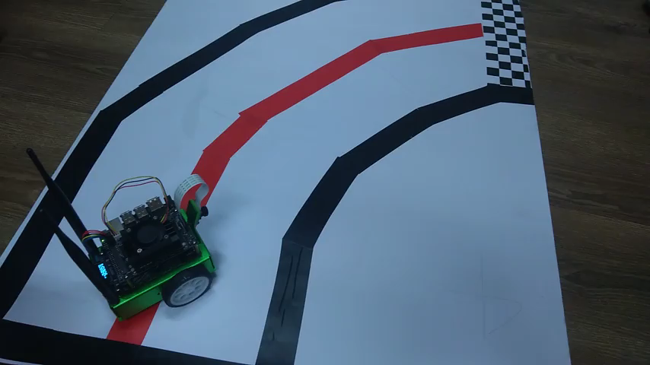
Example - first

Slide 23
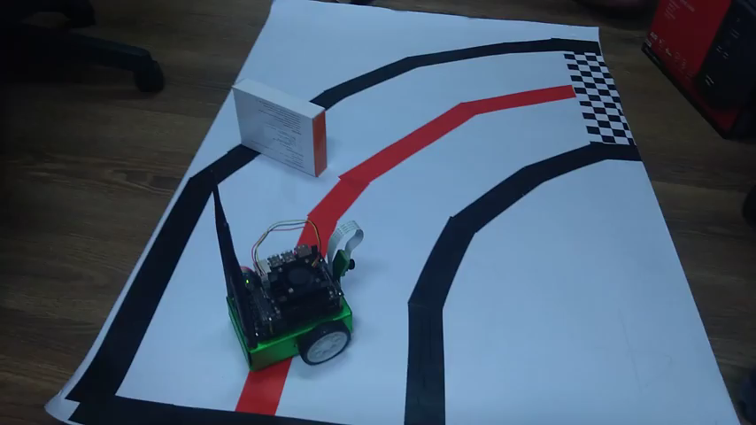
Example - second

Slide 24
Real world score – Details
 | Test map | Real map
Automatic tracking | Tracking red line: 4 points | Tracking red line: 8 points
Parking | Basic line: 1 point Perfect line: 3 points | Basic line: 2 points Perfect line: 6 points
Avoidance | 1 obstacle: 3 points (A little collision is ok) | 6 obstacles: 1 point/obstacle (A little collision is ok)
 | You can only restart at the origin | You can restart at the previous position 3 times

Slide 25
Demo date
7/1:
13:00~13:40
14:00~14:40
15:00~15:40
16:00~16:40
7/2:
8:00~8:40
9:00~9:40
10:00~10:40
11:00~11:40
13:00~13:40
14:00~14:40
Please contact the TAs if you cannot demo in these timeslots or have any problems.

Slide 26
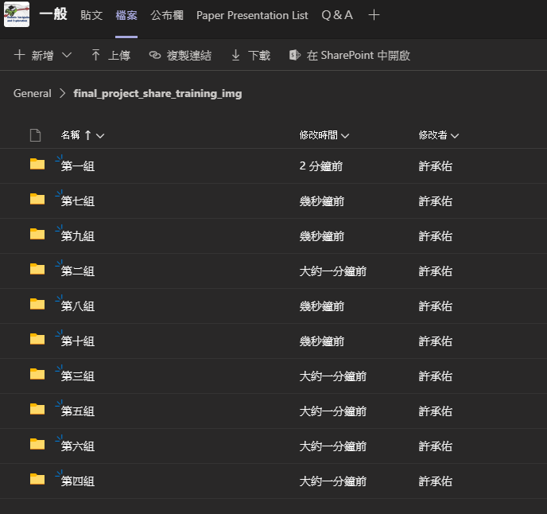
Data directory
Everyone can share the collected data via TEAMS.

Slide 27
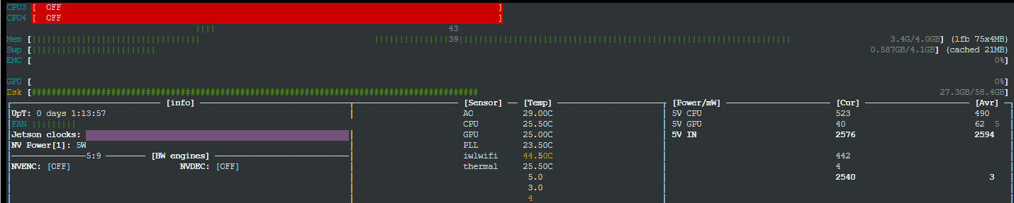
Hint 1 - memory usage
sudo -H pip3 install jetson-stats
sudo jtop
memory

Slide 28
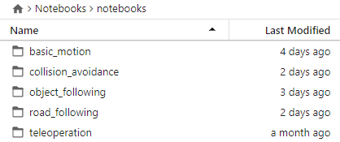
Hint 2 - reference code
JupyterLab
http://<jetbot_ip_address>:8888

Slide 29
Hint 3 - others
Recommend model: lightweight model, ex: shufflenet, mobilenet
Do not update pytorch
If your jetbot have any problem, you can restart the jetbot first!!!
(Ex: camera dead)

